Slide 1
Integrated Solid Waste and Fecal Sludge Management- Birendranagar Municipality
Mr Dev Kumar Subedi, Mayor, BM

Slide 2
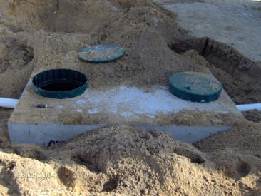
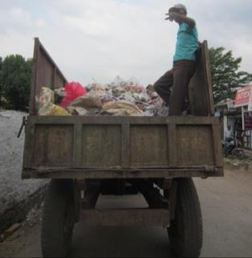
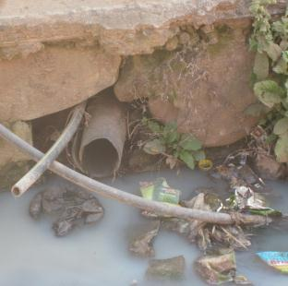
Background
City-wide Sanitation Plan approved by Birendranagar Municipal Council (2016):
Access to toilets for all locations
Waste water management and prefeasibility study for core area
Fecal sludge management
Solid waste management
Hazardous waste management
Drainage
Greenery

Slide 3
Landfill site- EIA 2009 7 km from city center

Slide 4
Background: health facilities
Hospital | 7
Health center | 2
Clinic/dispensary | 10
Health Post | 8
Total | 27

Slide 5
Background: health facilities- solid waste (2018)

Slide 6
Background: health facilities- solid waste (2018)

Slide 7
Background: health facilities- fecal sludge (2018)

Slide 8
Key strategies and started interventions
1) Minimise waste at all sources (reduce, segregate, recycle, reuse)
Municipality and Ward level guidelines- SWM
Different initiatives by Wards
School program
2) Timely and safe emptying of fecal sludge
Occupational health safety of emptiers (mechanical)
3) Minimise risk from hazardous waste
Private Medical Association collection/treatment
4) Safe treatment and disposal of solid and hazardous waste and fecal sludge
Design of Integrated Solid Waste and Fecal Sludge Processing Site

Slide 9
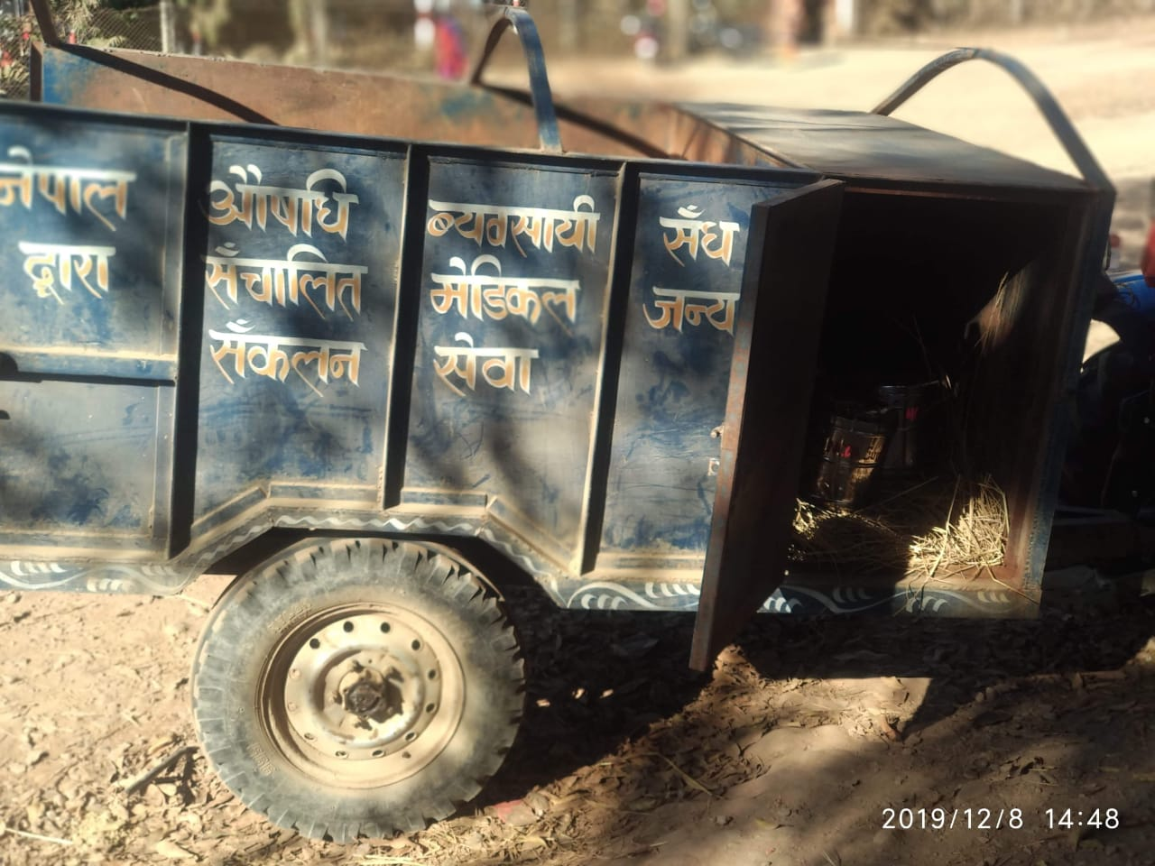
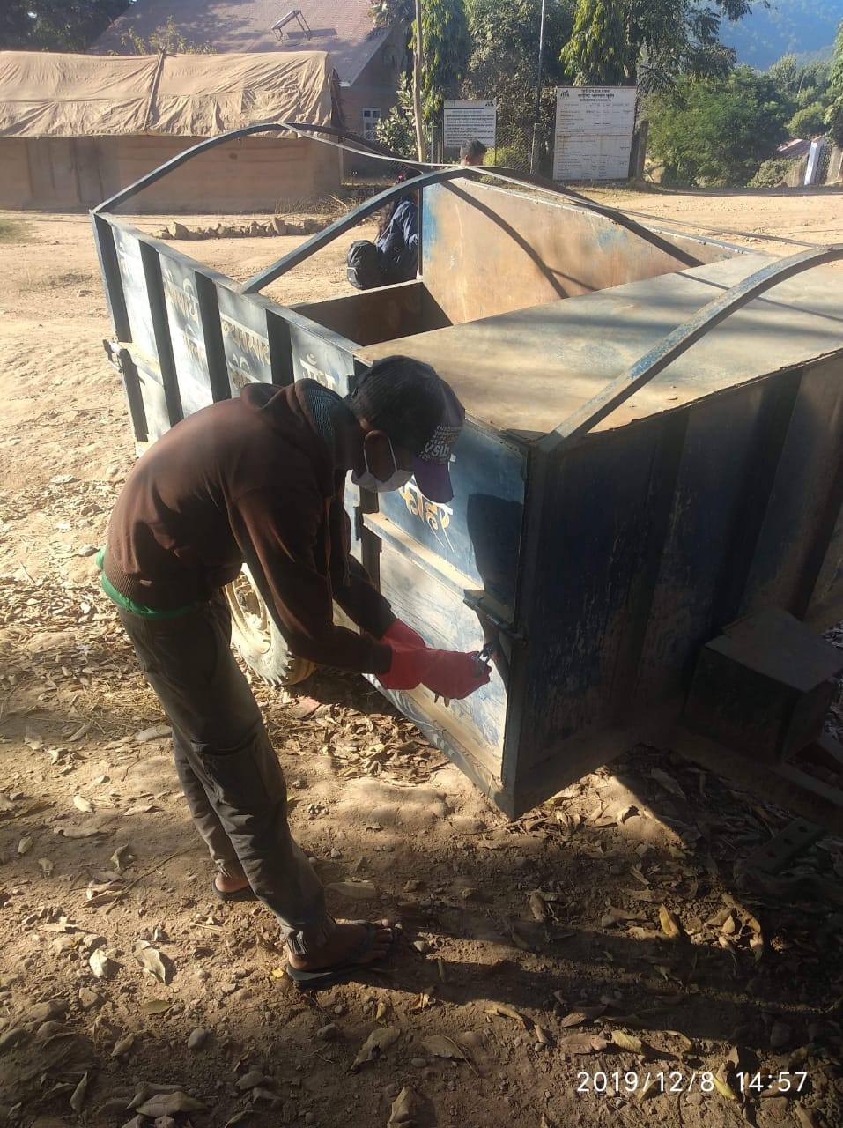
Current initiatives: Infectious waste segregation and collection and treatment by Private Medical Association (Sep 2019)

Slide 10
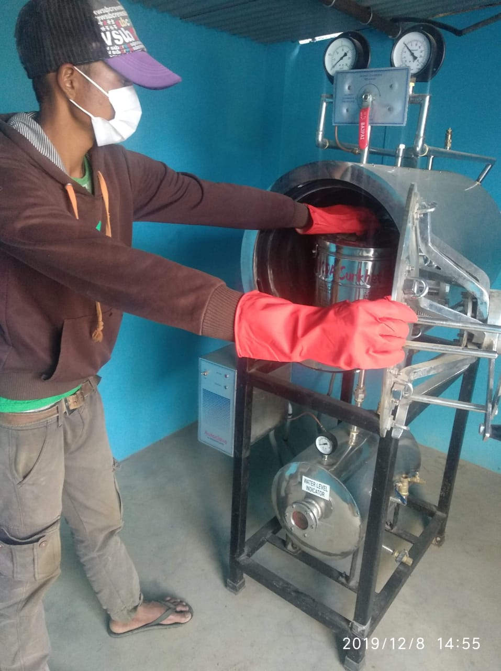
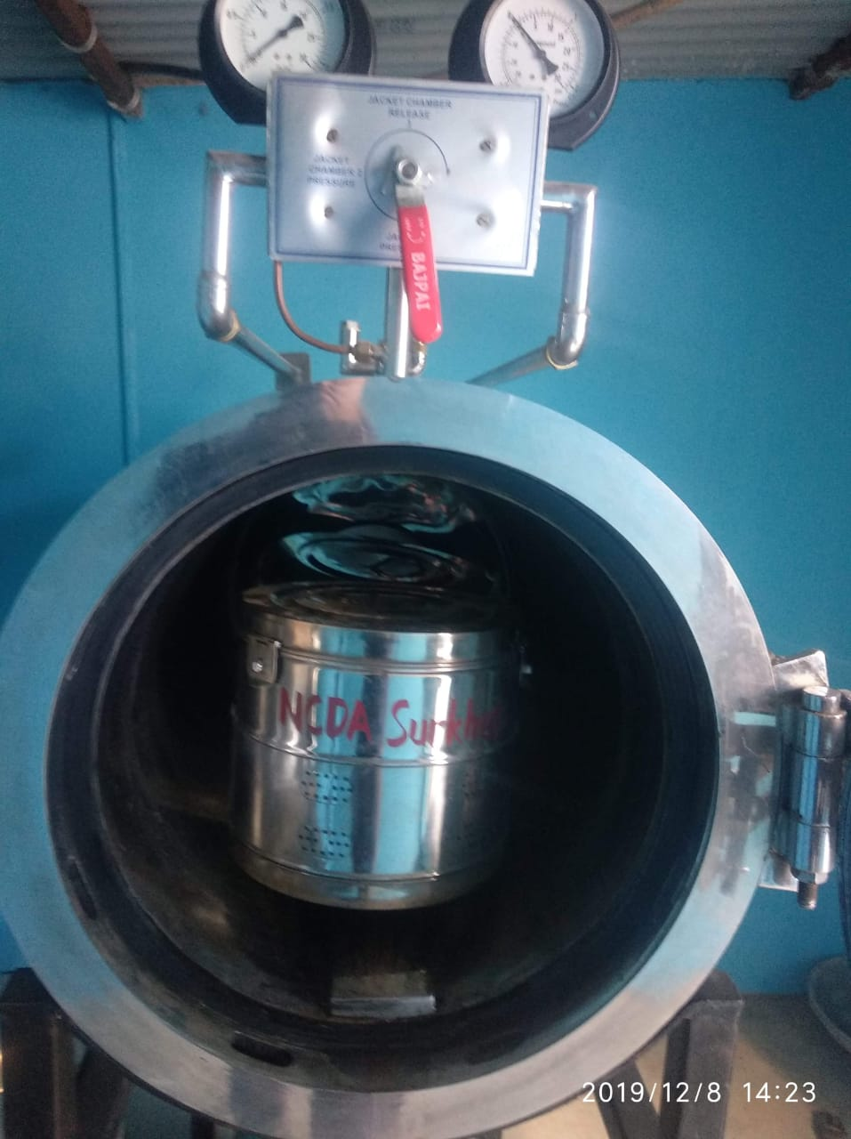
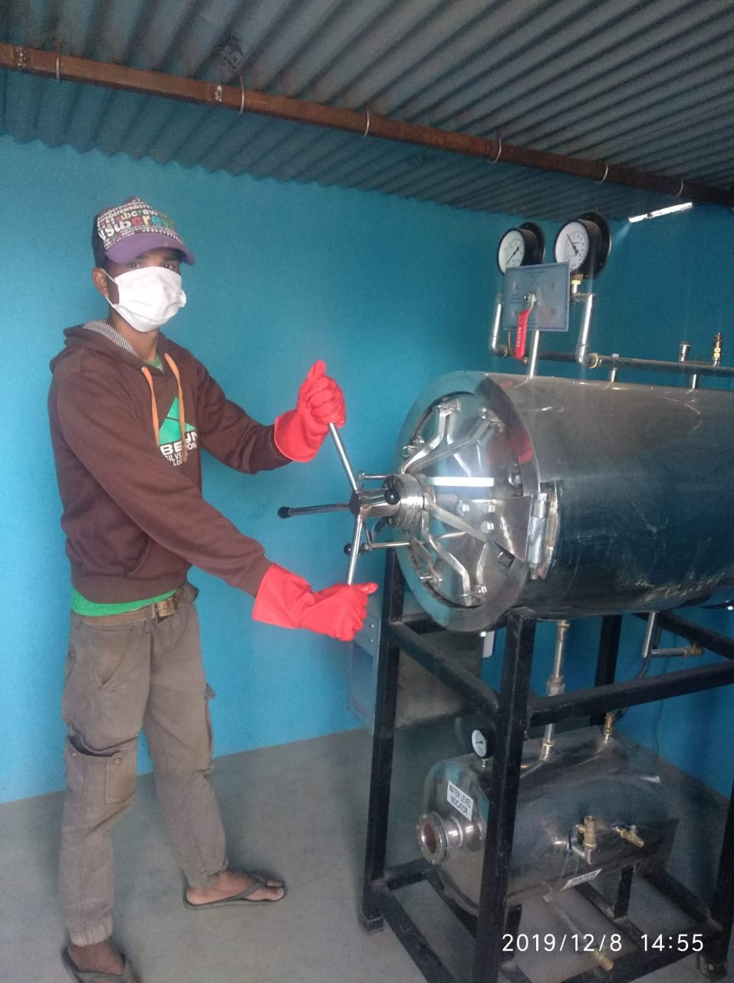
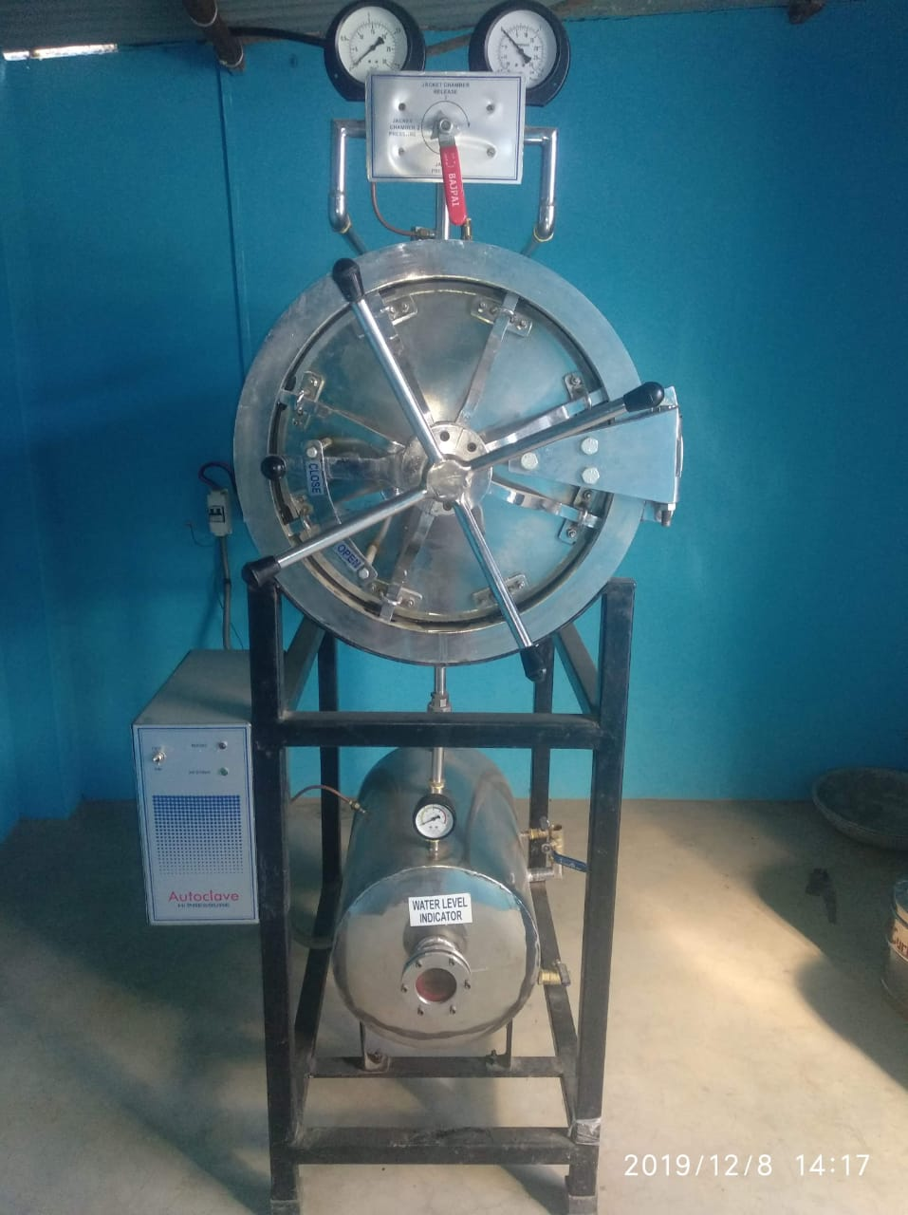
In process of agreeing on service charge allocation with Ward Chair

Slide 11
Current initiative: Design of Integrated Solid Waste and Fecal Sludge Processing Site (min. 20 yrs)
Benefits of Integration:
Single operational setup
Potential link of solid material flows
Potential link of liquid material flows
Synergies in operational and management modalities
Decision on Treatment Technologies:
Constructed wetland – beautification, emptied every 5 years, Forest groups can maintain and use material.
Composting of SW – compost can be used in surrounding area
No pumping in design; part-by-part design (cost; population expansion)

Slide 12
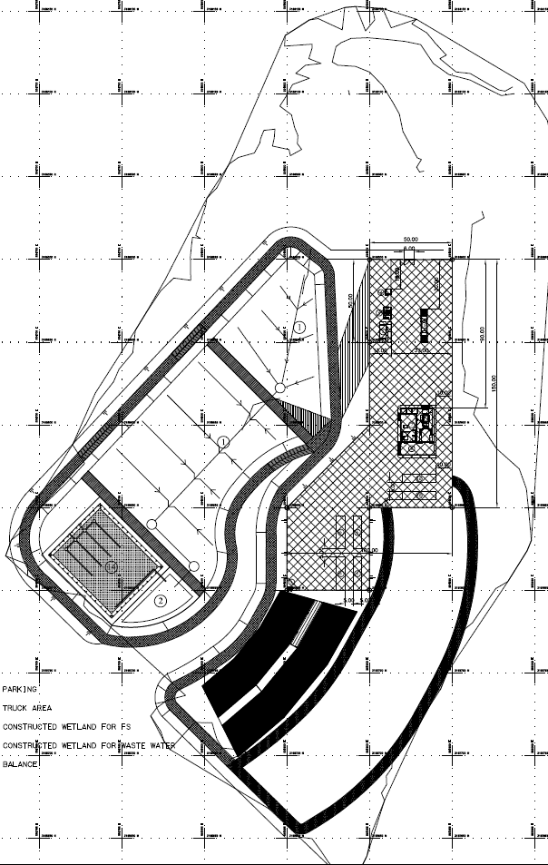
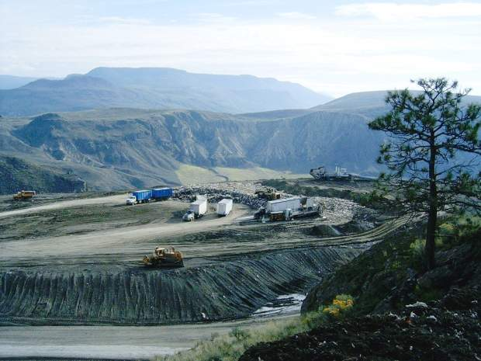
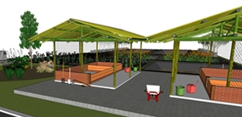
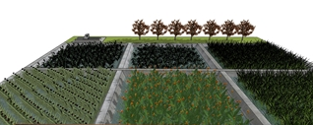
Sanitary landfill; hazardous landfill
Office, balance, segregation factory
Composting unit, curing house
Liquid wastewater treatment- wetland, pond
FS treatment- wetland

Slide 13
Objective | Phase | Cost
Start FS treatment Minimise waste dumping | FS treatment – 1st module Basic waste segregation Composting – 1st module | 1.8 crore
Expand FS treatment Further waste minimizing Safe solid waste disposal | Full segregation factory FS treatment- 2nd module Composting – 2nd module Sanitary landfill- 1st module Hazardous landfill- 1st module | 19 crore
Expand FS treatment Expand solid waste disposal | FS treatment- 3rd module Composting – 3rd module Sanitary landfill- 2nd module Hazardous landfill- 2nd module | 12 crore

Slide 14
THANK YOU!

